Slide 1

WOMEN SUPPORT GROUP
Life is tough, my darling,
But so are you.
- Stephanie Bennett-Henry
For all who are trying to conceive
DSI16 – Project 3
By Cheyanne Wong

Slide 2

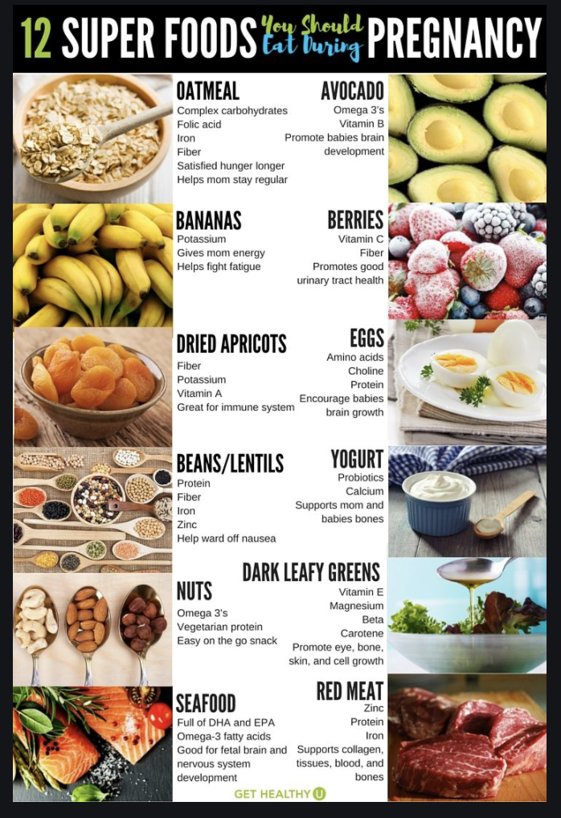
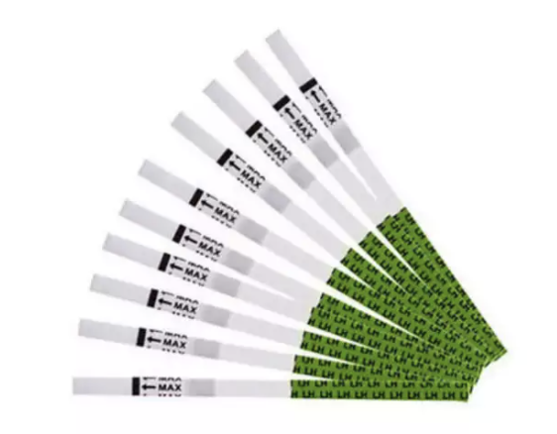
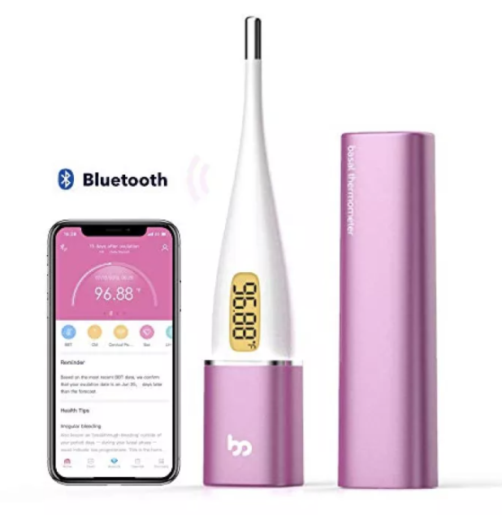
Problem Statement
To differentiate the group of women who are trying to conceive and those who experienced a miscarriage
To provide appropriate advice and support for each group
https://www.pinterest.com/pin
/177047829080437349
https://www.enanyang.my/

Slide 3

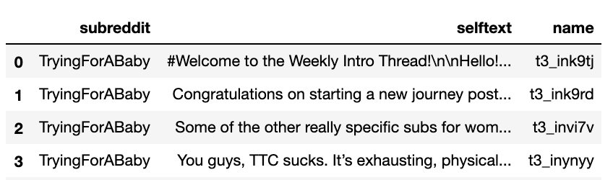
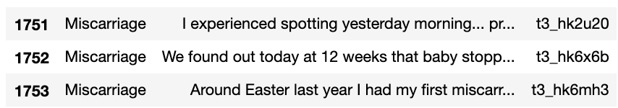
1. Gather Data
TRYING TO CONCEIVE → 'https://www.reddit.com/r/TryingForABaby’
MISCARRIAGE → 'https://www.reddit.com/r/Miscarriage'
877 posts
877 posts

Slide 4
2. Prepare Data
Dropped rows with the no / repeated text
Dropped welcome messages or instructions
Cleaning the text
Remove html text / Lower case / Remove stopwords / Stemming
Original Text:
Clean Text:
'My husband and I are 32, established in our careers, both type A personalities and have been TTC for over a year. \n\nWe wanted to wait a little longer n\nThe world makes it seem like you go off birth control and get pregnant on the first try.... not the case for us. Irregular periods, not ovulating, non progressive sperm... ‘
'husband establish career type person ttc year want wait littl longer world make seem like go birth control get pregnant first tri case us irregular period ovul non progress sperm’

Slide 5
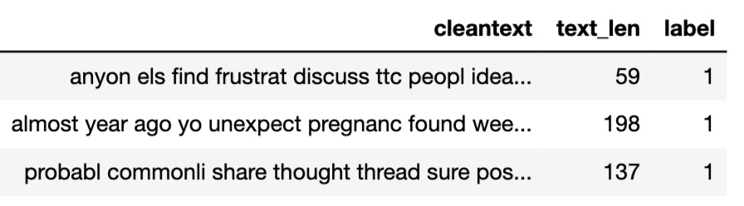
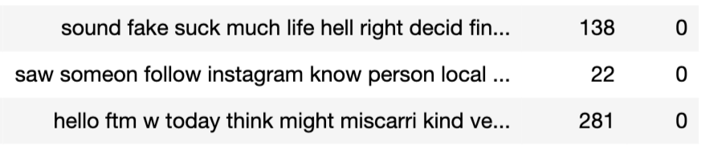
2. Prepare Data
‘TryingForABaby’ : 1
‘Miscarriage’ : 0

Slide 6
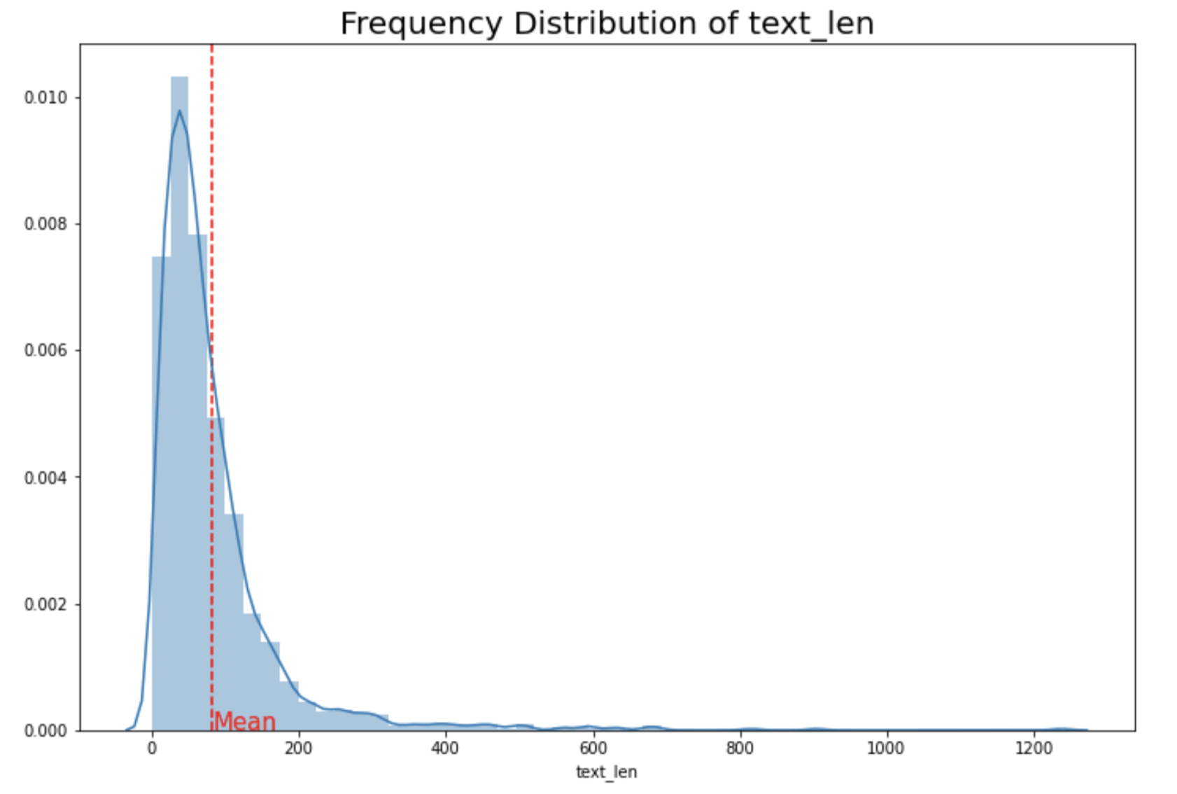
3. Exploratory Data Analysis
 | Trying To Conceive | Miscarriage
No. of entries | 875 | 826
Percentage breakdown | 51.4% | 48.6%
Average text length | 67.8 | 96.7
Median text length | 50 | 66.5
Minimum text length | 2 | 1
Maximum text length | 815 | 1237

Slide 7
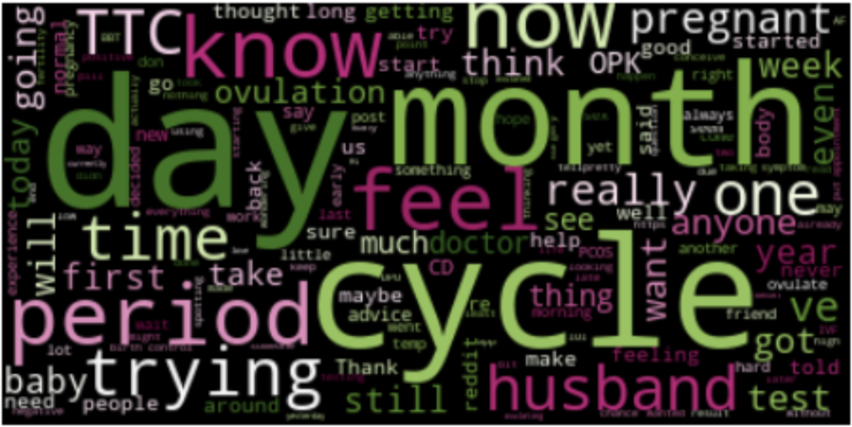
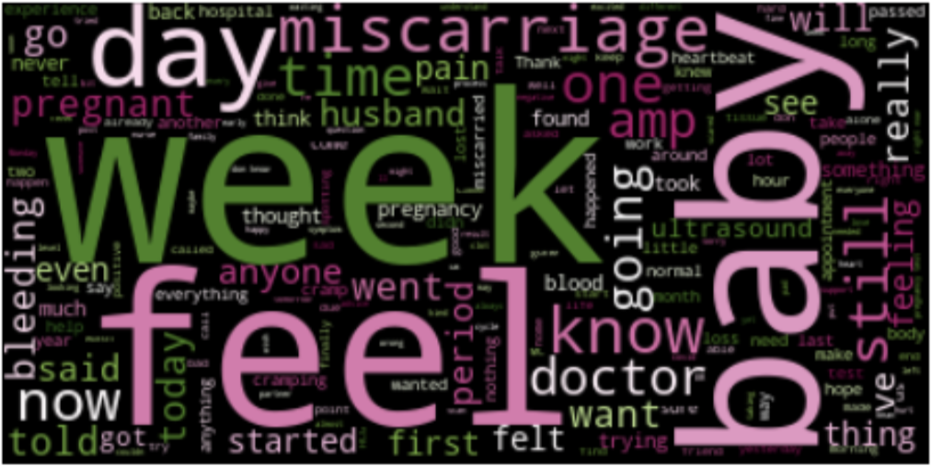
3. Exploratory Data Analysis
Trying to Conceive:
Miscarriage:

Slide 8
4. Modelling & Evaluation
 | Count Vectorizer |  | TFIDF Vectorizer
 | Train score | Test score | Train score | Test score
Logistic Regression | 0.998 | 0.911 | 0.961 | 0.927
KNN Classifier | 0.861 | 0.747 | 0.904 | 0.860
SVM | 0.953 | 0.919 | 0.997 | 0.929
Naïve Bayes | 0.937 | 0.929 | 0.937 | 0.904

Slide 9
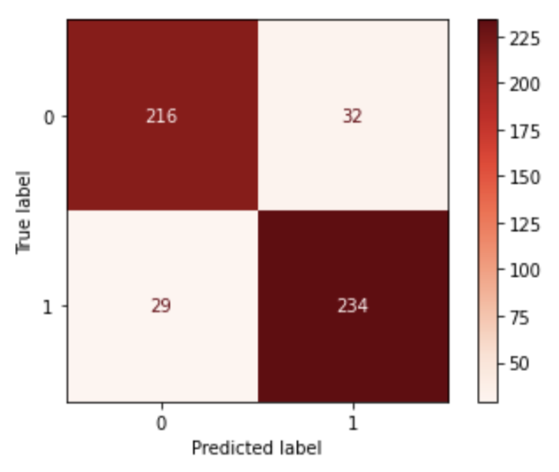
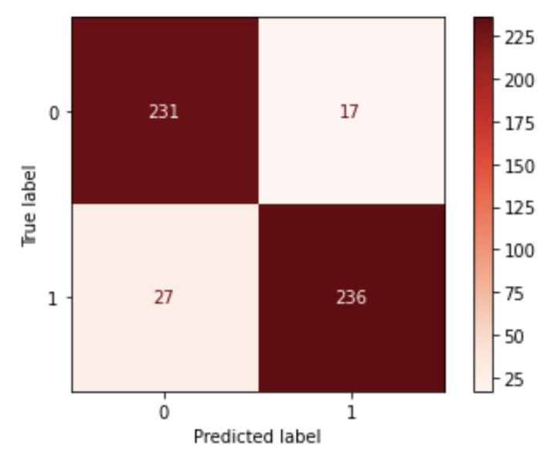
4. Modelling & Evaluation
Count vectorizer + SVM
Count vectorizer + Naïve Bayes
Accuracy | 88.1%
Sensitivity | 89.0%
Specificity | 87.1%
Precision | 88.0%
Accuracy | 91.4%
Sensitivity | 89.7%
Specificity | 93.1%
Precision | 93.3%

Slide 10
4. Modelling & Evaluation
Count Vectorizer parameters:
max_features : 2000
min_df : 4
max_df : 0.9
ngram_range : (1, 2)

Slide 11
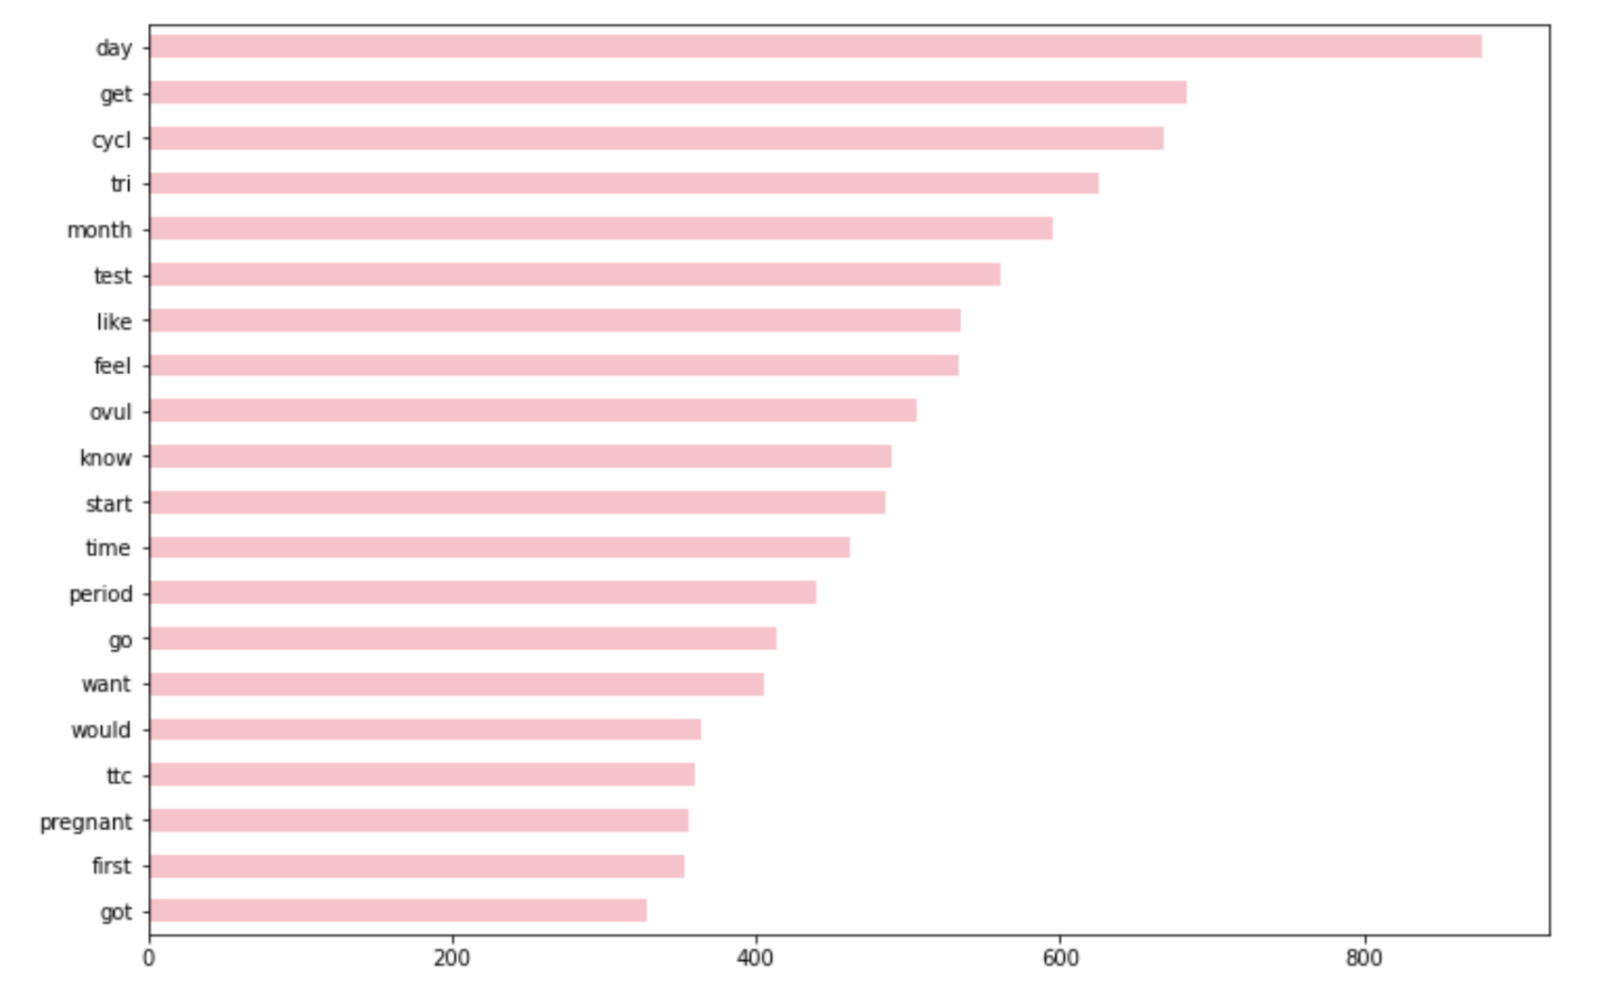
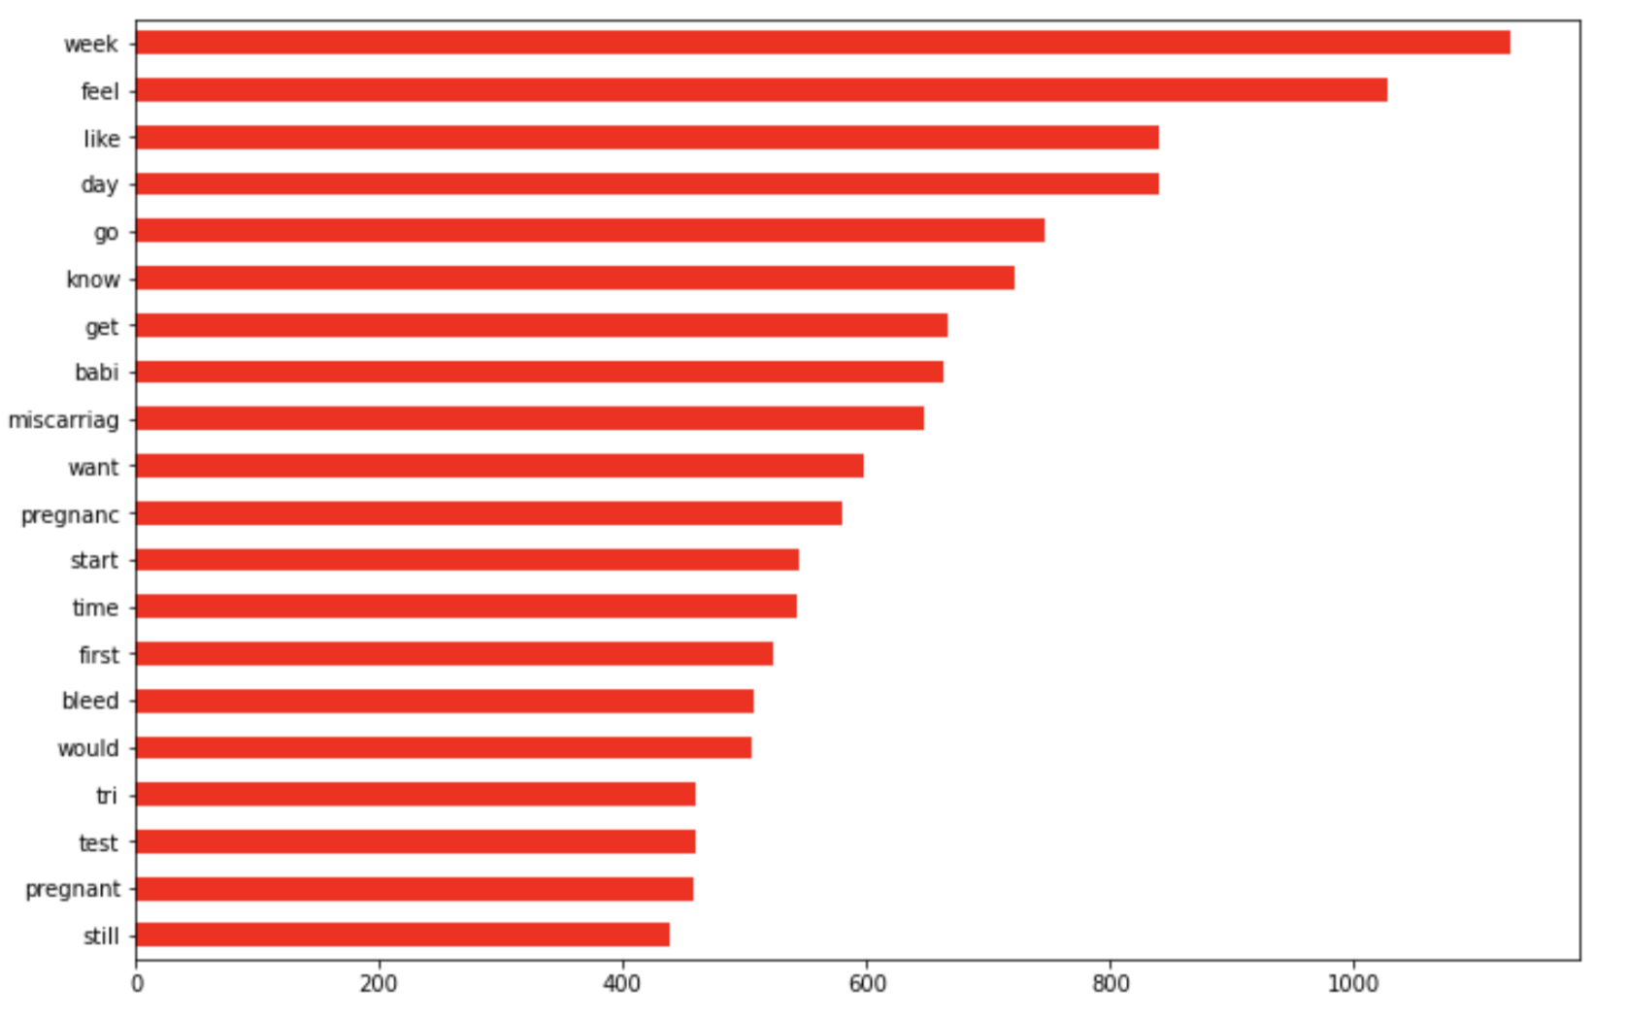
4. Modelling & Evaluation
day
get
cycl
tri
month
test
like
feel
ovul
know
start
time
period
go
want
would
ttc
pregnant
first
got
week
feel
like
day
go
know
get
babi
miscarriage
want
pregnanc
start
time
first
bleed
would
tri
test
pregnant
still
Trying To
Conceive
Miscarriage

Slide 12
5. Key Observations & Conclusion
Misclassification rate = 8.6%
Example:
This text is a false positive.
It is actually a post in r/Miscarriage.
Original text:
I have just done a pregnancy test and its a very, very faint line. This is in comparison from a few days ago when it was really dark. Will it just disappear in a few more days?
List of top common words in Miscarriage subreddit:
['day', 'dark', 'pregnanc', 'disappear', 'ago', 'test', 'realli', 'faint', 'done', 'line’]
List of top common words in TryingForABaby subreddit:
['day', 'dark', 'pregnanc', 'ago', 'test', 'realli', 'faint', 'done', 'line']
P(Trying) x P(word_{i}|Trying) > P(Miscarriage) x P(word_{i}|Miscarriage)

Slide 13
5. Key Observations & Conclusion
With our model, we are able to correctly classify 91.4% of the posts and provide the right support to the respective groups. We also wish to target advertisement to the group identified as ’Miscarriage’ for them to join our community to get the right support.
To improve on our model accuracy, we can analyze the common words in both groups and include more words as stop-words, then apply TF-IDF vectorizer again to give more weights to words that has lower occurrence.

Slide 14
THE END ~ Thank you

